Slide 1
Credit EDA Assignment
© Templateswise.com
By:
K Madush
k.madush999@gmail.com

Slide 2
Business Understanding
The loan providing companies find it hard to give loans to the people due to their insufficient or non-existent credit history. Because of that, some consumers use it as their advantage by becoming a defaulter.
When the company receives a loan application, the company has to decide for loan approval based on the applicant’s profile.
Two types of risks are associated with the bank’s decision:
If the applicant is likely to repay the loan, then not approving the loan results in a loss of business to the company.
If the applicant is not likely to repay the loan, i.e. he/she is likely to default, then approving the loan may lead to a financial loss for the company.

Slide 3
Business Objectives
Objective is to identify the driving factors (or driver variables) behind loan default, i.e. the variables which are strong indicators of default.
Also, Identify patterns which indicate if a client has difficulty paying their installments which may be used for taking actions such as denying the loan, reducing the amount of loan, lending (to risky applicants) at a higher interest rate, etc. This will ensure that the consumers capable of repaying the loan are not rejected. Identification of such applicants using EDA is the aim of this case study.

Slide 4
Analysis approach
Read the Dataset.
Check for Data imbalance.
Perform univariate, bivariate/multivariate analysis in individual segments.
Data Cleaning, Missing Data Handling, Type casting are done segment wise.
Perform Data Visualization segment-wise as well.

Slide 5
DATA UNDERSTANDING

Slide 6
Dataset
1. 'application_data.csv' contains all the information of the client at the time of application. The data is about whether a client has payment difficulties.
2. 'previous_application.csv' contains information about the client’s previous loan data. It contains the data whether the previous application had been Approved, Cancelled, Refused or Unused offer.
3. 'columns_description.csv' is data dictionary which describes the meaning of the variables.

Slide 7
Application Data Dataset
<class 'pandas.core.frame.DataFrame'>
RangeIndex: 307511 entries, 0 to 307510
Columns: 122 entries, SK_ID_CURR to AMT_REQ_CREDIT_BUREAU_YEAR
dtypes: float64(65), int64(41), object(16)
memory usage: 286.2+ MB
'application_data.csv’ contains 121 features columns, 1 target column, and 307511 rows.
Previous Application Dataset
<class 'pandas.core.frame.DataFrame’>
RangeIndex: 307511 entries, 0 to 307510
Columns: 122 entries, SK_ID_CURR to AMT_REQ_CREDIT_BUREAU_YEAR
dtypes: float64(65), int64(41), object(16)
memory usage: 286.2+ MB
‘previous_application.csv’ have 37 features columns and 1670214 rows

Slide 8
DATA CLEANING

Slide 9
Identify the missing values
['OWN_CAR_AGE', 'EXT_SOURCE_1', 'APARTMENTS_AVG', 'BASEMENTAREA_AVG', 'YEARS_BUILD_AVG', 'COMMONAREA_AVG', 'ELEVATORS_AVG', 'ENTRANCES_AVG', 'FLOORSMIN_AVG', 'LANDAREA_AVG', 'LIVINGAPARTMENTS_AVG', 'LIVINGAREA_AVG', 'NONLIVINGAPARTMENTS_AVG', 'NONLIVINGAREA_AVG', 'APARTMENTS_MODE', 'BASEMENTAREA_MODE', 'YEARS_BUILD_MODE', 'COMMONAREA_MODE', 'ELEVATORS_MODE', 'ENTRANCES_MODE', 'FLOORSMIN_MODE', 'LANDAREA_MODE', 'LIVINGAPARTMENTS_MODE', 'LIVINGAREA_MODE', 'NONLIVINGAPARTMENTS_MODE', 'NONLIVINGAREA_MODE', 'APARTMENTS_MEDI', 'BASEMENTAREA_MEDI', 'YEARS_BUILD_MEDI', 'COMMONAREA_MEDI', 'ELEVATORS_MEDI', 'ENTRANCES_MEDI', 'FLOORSMIN_MEDI', 'LANDAREA_MEDI', 'LIVINGAPARTMENTS_MEDI', 'LIVINGAREA_MEDI', 'NONLIVINGAPARTMENTS_MEDI', 'NONLIVINGAREA_MEDI', 'FONDKAPREMONT_MODE', 'HOUSETYPE_MODE', 'WALLSMATERIAL_MODE']
Above mentioned columns are identified to have missing value percentage more than 50%.
It’s good to drop those columns.

Slide 10
Identify the missing values
['AMT_ANNUITY', 'CNT_FAM_MEMBERS', 'DAYS_LAST_PHONE_CHANGE']
Above mentioned columns are identified to have missing value percentage less than 0.05%.
It’s good to drop respective rows having missing values.
And replacing missing values with mode of respective columns whose missing value percentage range from 0 to 50%

Slide 11
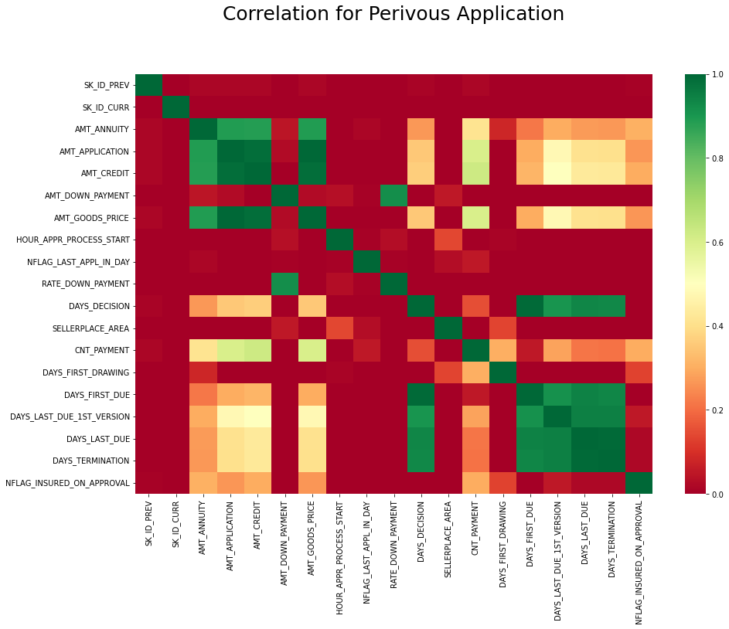
Correlation for Pervious Application
'DAYS_LAST_DUE' and 'DAYS_TERMINATION' are highly correlated 'DAYS_FIRST_DRAWING' and 'DAYS_LAST_DUE_1st_VERSION' have high negative correlation 'AMT_ANNUITY','AMT_APPLICATION','AMT_CREDIT','AMT_GOODS_PRICE' are highly correlated The features can be removed from data, as they would cause collinearity.
'SK_ID_PREV' column is not required for analysis drop them.

Slide 12
DATA IMBALANCE

Slide 13
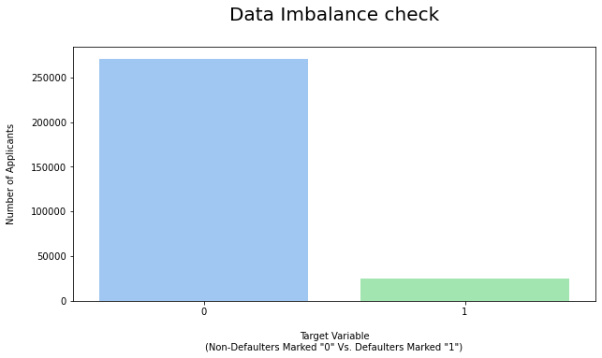
Identify the Data Imbalance
Univariate Analysis
Percentage of Defaulters: 8.07%
Percentage of Non - Defaulters: 91.92%
As we can see in above bar Plot Data is highly imbalance The Ratio between defaulters and Non-defaulters is nearly 2:23.
Suggesting us to analysis it separately.

Slide 14
OUTLIERS ANALYSIS

Slide 15
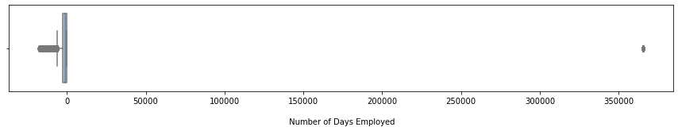
Identify the outliers
Univariate Analysis
Above Box Plot shows Outliers in Number of Days Employed. Many applicants are Unemployed for many days and Employed this will not give us proper insight.
Suggested Analysis Solution:
Perform Bivariate Analysis by Filter Data to Defaulter alone and Number of Days Employed value for 0 to 99 Percentile.

Slide 16
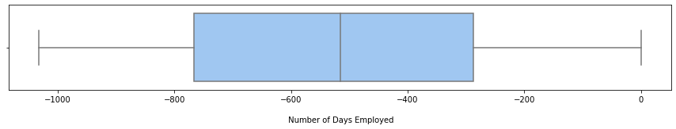
Filtering the outliers
Bivariate Analysis
Most of the Applicants who are not working from past range of 400 to 600 days tend to default more.

Slide 17
SEGMENT WISE UNIVARIATE , BIVARITATE/MULTIVARITATE ANALYSIS

Slide 18
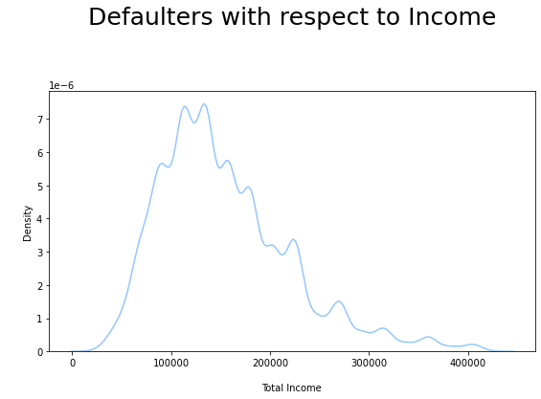
Variable Analysis
Bivariate numeric Analysis
We can see from plot applicant whose Income ranging from Rs.100000 to Rs.200000 tend to Default more.
Also, We can see that as Income of Applicant increase chance of default rate decrease.

Slide 19
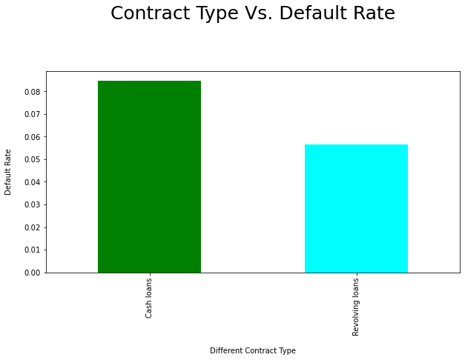
Variable Analysis
Categorical Analysis
Cash loan tend to have higher default Rate as per Application Data.
CONTRACT TYPE DEFAULT RATE
Cash loans 0.084701
Revolving loans 0.056385

Slide 20
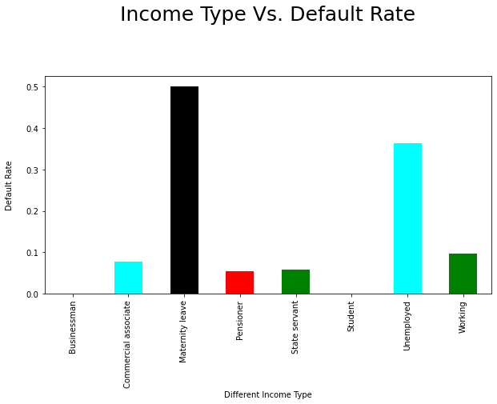
Variable Analysis
Categorical Analysis
Most of defaulters Income is from Maternity leave or Unemployed.
Student & Businessman tend to have less default rate (It is possible Student are taking Education loan at low interest).
INCOME TYPE DEFAULT RATE
Maternity leave 0.500000
Unemployed 0.363636
Working 0.096882
Commercial associate 0.077252
State servant 0.058704
Pensioner 0.054319
Businessman 0.000000
Student 0.000000

Slide 21
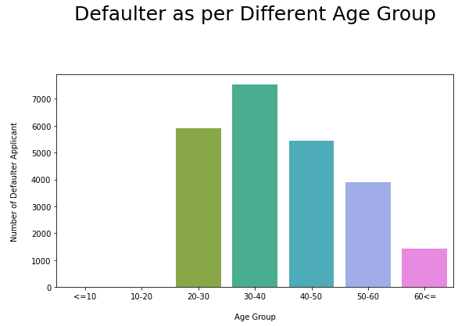
Variable Analysis
Bivariate Numeric Analysis
Applicate whose fall underage group of 30-40 tend to default more.
Applicate whose age is more than 60 tend to default less.

Slide 22
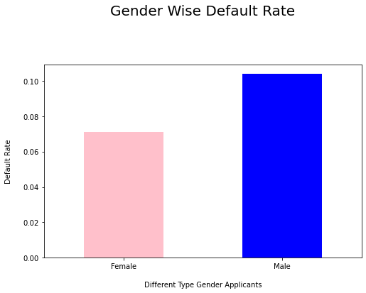
Variable Analysis
Categorical Analysis
Most defaulter tend to be male.
DIFFERENT GENDER DEFAULT RATE
Female 0.070936
Male 0.103883

Slide 23
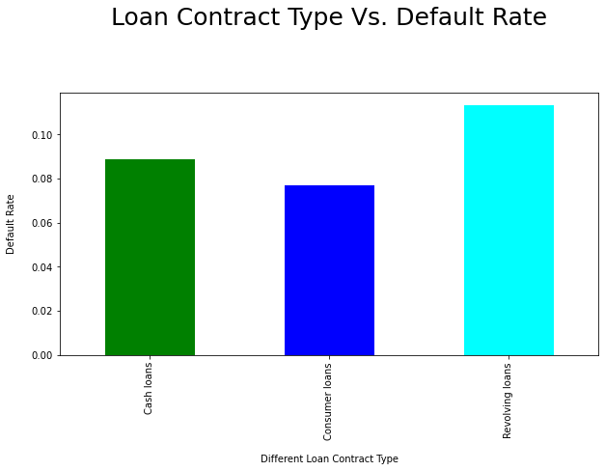
Variable Analysis
Categorical Analysis
Most defaulter tend to be Revolving loans as per Previous application data.
DIFFERENT CONTRACT TYPE DEFAULT RATE
Revolving loans 0.113399
Cash loans 0.088970
Consumer loans 0.076988

Slide 24
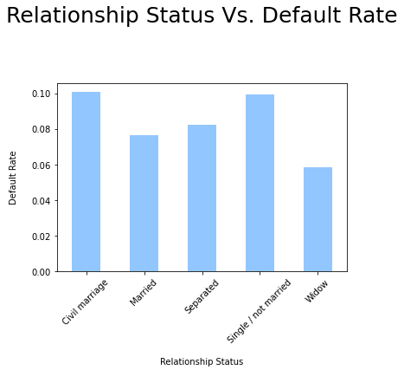
Variable Analysis
Categorical Analysis
Default rate is high for Applicants whose Relationship status is Civil marriage and Single / not married
Different Relationship Status Default Rate
Civil marriage 0.100908
Single / not married 0.099427
Separated 0.082513
Married 0.076942
Widow 0.058720

Slide 25
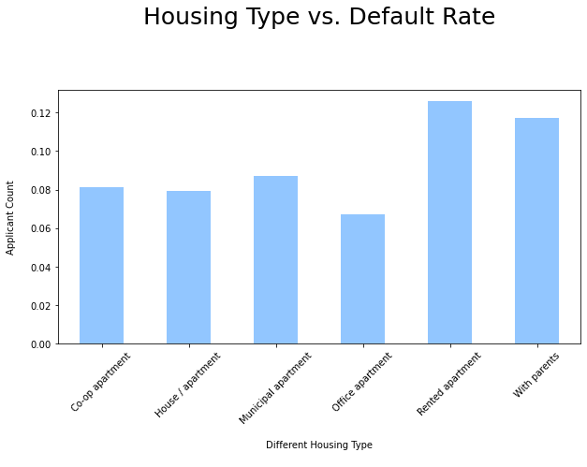
Variable Analysis
Categorical Analysis
Applicants living With parents and in Rented apartment have higher Default rate.
Applicant living in Office apartment have less Default Rate.
Different Housing Type Default Rate
Rented apartment 0.125661
With parents 0.117253
Municipal apartment 0.086948
Co-op apartment 0.081331
House / apartment 0.079218
Office apartment 0.067179

Slide 26
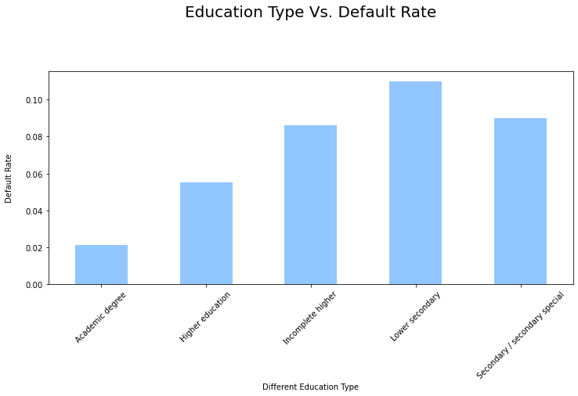
Variable Analysis
Categorical Analysis
Applicant whose “EDUCATION TYPE” is Lower secondary tend to have higher default rate.
Applicant whose “EDUCATION TYPE” is Academic degree tend to have less default rate.
DIFFERENT EDUCATION_TYPE DEFAULT RATE
Lower secondary 0.109785
Secondary / secondary special 0.090021
Incomplete higher 0.086166
Higher education 0.055026
Academic degree 0.021127

Slide 27
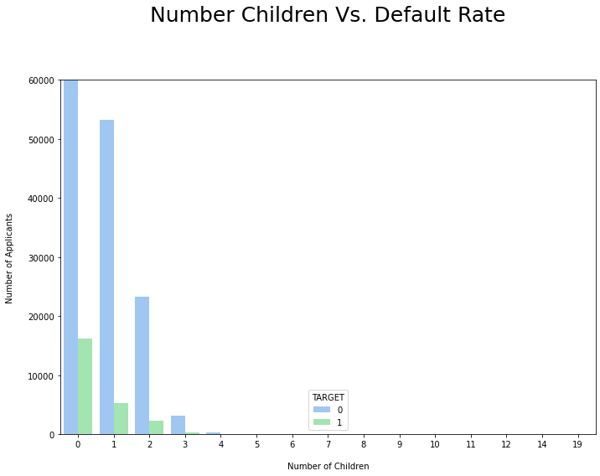
Variable Analysis
Bivariate Numeric Analysis
Most defaulter tend to be male. Applicant having no Children tend to have high default rate.

Slide 28
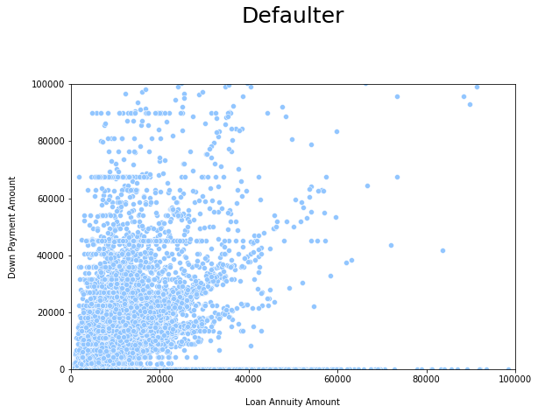
Variable Analysis
Multivariate Analysis
Number of defaulters are less as amount of annuity increase of previous application.
Also, for higher down payment, defaulter cases are less.

Slide 29
CORRELATION ANALYSIS

Slide 30
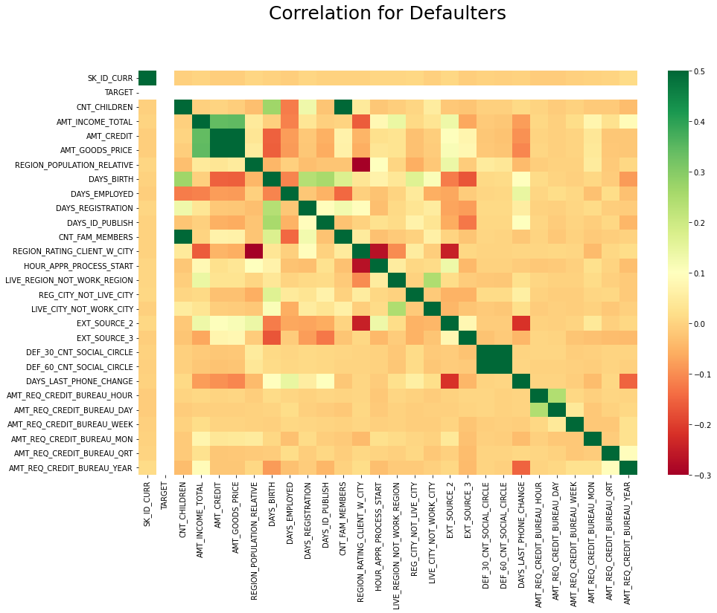
Correlation of Defaulters
Top 10 Correlation of Defaulters:
('AMT_CREDIT', 'AMT_GOODS_PRICE’)
('DEF_60_CNT_SOCIAL_CIRCLE', 'DEF_30_CNT_SOCIAL_CIRCLE’)
('CNT_CHILDREN', 'CNT_FAM_MEMBERS’)
('AMT_INCOME_TOTAL', 'AMT_GOODS_PRICE’)
('AMT_INCOME_TOTAL', 'AMT_CREDIT’)
('CNT_CHILDREN', 'DAYS_BIRTH’)
('DAYS_REGISTRATION', 'DAYS_BIRTH’)
('CNT_FAM_MEMBERS', 'DAYS_BIRTH’)
('DAYS_ID_PUBLISH', 'DAYS_BIRTH’)
('LIVE_CITY_NOT_WORK_CITY', 'LIVE_REGION_NOT_WORK_REGION')

Slide 31
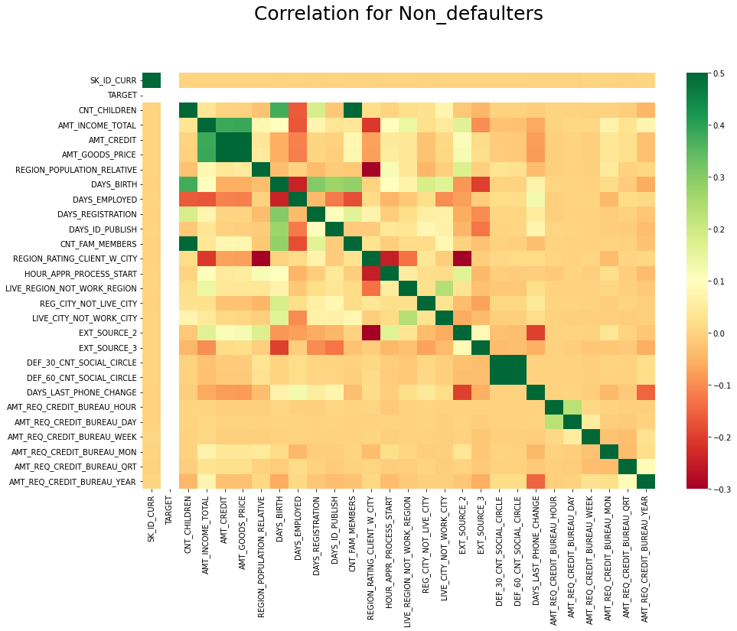
Correlation of Non-Defaulters
Top 10 Correlation of Non-Defaulters:
('AMT_CREDIT', 'AMT_GOODS_PRICE’)
('DEF_60_CNT_SOCIAL_CIRCLE', 'DEF_30_CNT_SOCIAL_CIRCLE’)
('CNT_CHILDREN', 'CNT_FAM_MEMBERS’)
('AMT_INCOME_TOTAL', 'AMT_GOODS_PRICE’)
('AMT_INCOME_TOTAL', 'AMT_CREDIT’)
('CNT_CHILDREN', 'DAYS_BIRTH’)
('DAYS_REGISTRATION', 'DAYS_BIRTH’)
('CNT_FAM_MEMBERS', 'DAYS_BIRTH’)
('DAYS_ID_PUBLISH', 'DAYS_BIRTH’)
('LIVE_CITY_NOT_WORK_CITY', 'LIVE_REGION_NOT_WORK_REGION')

Slide 32
Features Identifying Defaulters:
Applicants living With parents and in Rented apartment has high chances of being Defaulter.
When client's contact address does not match work address there is high chances of being Defaulter.
Region 2 defined by company has high chances of being Defaulter.
Applicant who don't own a CAR and own a REALTY has high chances of being Defaulter.
Applicants whose Family Status is Civil marriage and Single / not married has high chances of being Defaulter.
Applicant having no Children tend to have high default rate.
Applicant having family member count 2 tend to have high default rate (Might be because they are just couples).
Applicate whose OCCUPATION_TYPE is Low-skill Laborers tend to have higher default rate.
Applicate whose EDUCATION_TYPE is Lower secondary tend to have higher default rate.
Most defaulter tend to be Male.

Slide 33
Features Identifying Defaulters:
Applicate whose fall underage group 30-40 tend to have high chances of being Defaulter.
Most of defaulter are accompanied by "Other_B“.
Most of defaulter Income is from Maternity leave or Unemployed.
Cash loan tend to have higher default Rate.
We can see as Income of Client increase chance of default rate decrease. People with less income tend to default more.
Most of the client who are not working from past range of 400 to 600 days tend to default.
"Cards" defaulter percentage is highest (17%). 'NAME_PORTFOLIO' is an important feature for analyzing 'TARGET' variable.
15% loan applicant defaulted for AP+ (Cash Loan). 'CHANNEL_TYPE' is an important feature for analyzing 'TARGET' variable.
Highest percentage (17%) of default cases is for 'Card Street'. 'PRODUCT_COMBINATION' is an important driving factor.

Slide 34
Features Identifying Defaulters:
Number of defaulters are less as amount of annuity increase of previous application.
For higher down payment, defaulter cases are less.
For those who had lower rate of down payment in previous application, cases of default are higher.
Most of the default are from Revolving loans.
'SCO', 'LIMIT' and 'HC' are the most common reason of rejection.
Most of the defaulters did not request insurance during previous loan application.
Most of the defaulters are Repeated clients.
Most of the defaulters payment type is cash through bank.
Insurance tend to have highest default rate.
Highest default rate is in case of Cash Product.

Slide 35
Features Identifying Non-Defaulters:
Applicant living in Office apartment have less Default Rate.
Region 1 defined by company has less defaulters.
Applicate whose OCCUPATION_TYPE is Accountants tend to have less default rate.
Applicate whose EDUCATION_TYPE is Academic degree tend to less default rate.
Male tend to be less Defaulter compared to Female.
Applicate whose age is more than 60 tend to has less chances of being Defaulter .
Businessman tend to have less default rate.

Slide 36
Thank you

